Slide 1
Lesson 4: Scaling Linear Sensors and Transducers
ET 438a
Automatic Control Systems Technology

Slide 2
Learning Objectives
After this presentation you will be able to:
Develop mathematical relationships for a sensor that has a linear output.
Convert linear mathematical equations into block diagrams that represent sensor scaling circuits.
Adjust the output range of a sensor using operational amplifier circuits.

Slide 3
Scaling Sensor Outputs
x= transducer input
(measured value)
V_{T} = transducer output
voltage
K_{T} = transducer gain
(slope)
K_{s} = scalar gain
V_{s} = scalar output
V_{T}
V_{T2}
K_{T}
V_{T1}
Span = max. value - min. value
x₁
x₂
x

Slide 4
Sensor Scaling Case 1: No Offset in Scalar or Sensor
V_{T}
Transducer gain formula: V_{T} = K_{T}x
Required scalar gain:
Scalar output formula
K_{s}
K_{T}
x
Block Diagram
Sensor
K_{T}
V_{T}
Scalar
K_{s}
V_{s}
x
Input
Output
V_{T} = K_{T}x
V_{s} = K_{s}V_{T}

Slide 5
Example 4-1: Case 1 Sensor
A pressure transducer has a usable range P (x) range of 0-50 psig (lb/in² gauge). It has a voltage output range of 0-1.25 Vdc over the pressure range. Scale the output to a range of 0-10 Vdc
Find K_{T}
Find scalar gain
P
K_{T}=0.025 V/psig
V_{T}
K_{s}=8 V/V
V_{s}

Slide 6
Sensor Scaling Case 2: Offset in Sensor No Offset in Output
Sensor gain formula: V_{T} = K_{T}x + b
Where b = transducer offset
V_{T}
K_{s}
Scalar gain formula must subtract offset
K_{T}
Correct
form of
scalar output
b
x
Scalar
equation
Block diagram
x
Sensor
K_{T}∙x+b
V_{T}
Scalar
K_{s}∙V_{T}- K_{s}∙ b
V_{s}
V_{T}=K_{T}∙x+b
V_{s}=K_{s}∙V_{T}- K_{s}∙ b

Slide 7
Example 4-2: Offset Sensor Output Range
A temperature transducer has a range of 0-100 C (input x) It has a voltage output range of 1-5 Vdc (V_{T}) over this temperature range. Scale the output to a range of 0-10 Vdc. Find the transducer gain, K_{T}, and the offset,b. Find the scalar relationship required to get the desired output range. Draw a block diagram of this sensor/scalar system that includes the mathematical relationship derived above.
Find K_{T}
Find b from point slope form of line
b=1.0

Slide 8
Example 4-2: Solution (2)
Find scalar gain
Scalar formula
Block Diagram
Input
V_{T}
V_{s}
Transducer
0.04x+1
Scalar
2.5V_{T}-2.5
x
Output
V_{T}= 0.04x+1
V_{s} = 2.5V_{T}-2.5

Slide 9
Sensor Scaling Case 3: Transducer with no offset, Output offset
V_{T}
Transducer gain formula:
V_{T} = K_{T}x
K_{s}
c = scalar offset can be +- value
K_{T}
Scalar formula must add a constant
x
c
To find c, use point slope form using scalar points

Slide 10
Example 4-3: Case 3 Sensor Scaling
A pressure transducer has an input range of 0 - 25 psig (x) and an output range of 0 - 1 V (V_{T}) Find the scaling equation to convert this range into the desired range of -5 V to +5 Vdc) Find transducer gain and scalar gain formulas. Draw the block diagram of the complete system
Find K_{T}
Find K_{s}

Slide 11
Example 4-3: Solution (2)
Use point-slope form of line to find the value of c
Can use either point
in pair defining range
Scalar gain formula
c=-5
Block Diagram
Input
V_{T}
V_{s}
Transducer
0.04x
Scalar
10V_{T}-5
x
Output
V_{T}= 0.04x
V_{s} = 10V_{T}-5

Slide 12
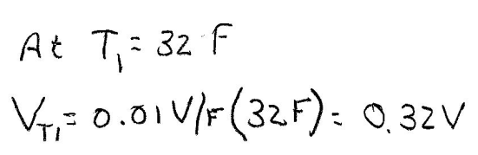
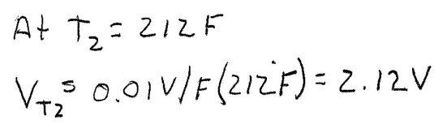
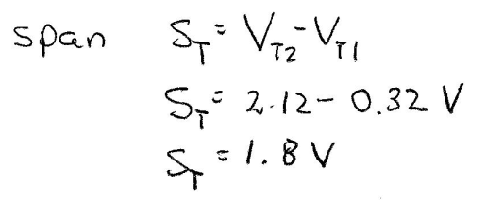
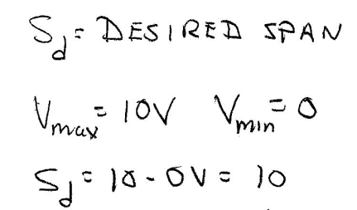
Example 4-4 Scalar Equations
Range of linear temperature transducer is 32- 212 F with a transducer gain of 10 mV/F. The desired output of the transducer for the range of temperature is 0 - 10 Vdc. Find the gain formula.
Find span of transducer
2.12
0.32
Move origin to (32, 0.32)

Slide 13
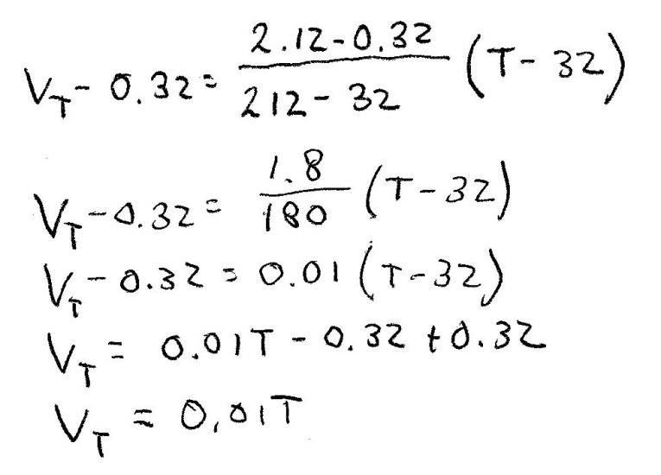
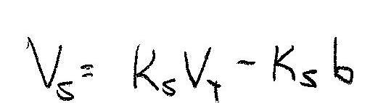
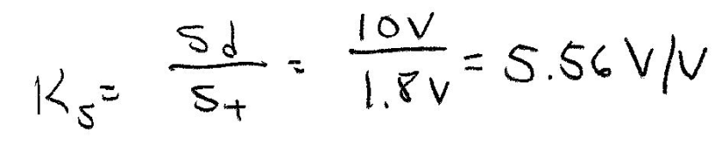
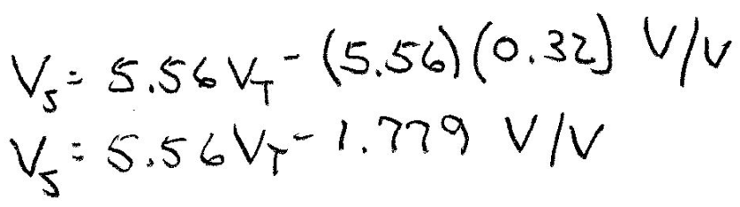
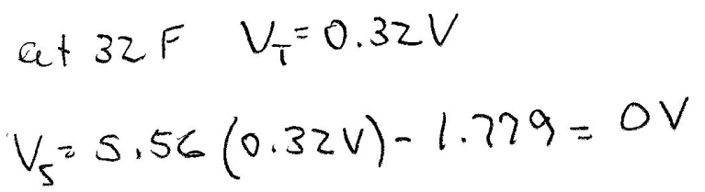
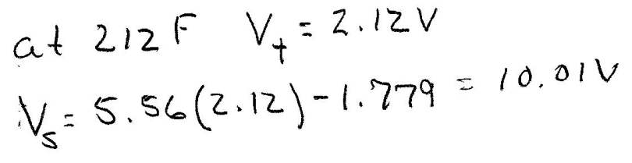
Example 4-4 Solution (2)
Compute sensor equation
Shift origin to (32 F, 0.32 V)
So b=0.32
Check equation at data points

Slide 14
Example 4-4 Solution (3)
Block Diagram
Input
Temp
V_{T}
V_{s}
Transducer
0.01x
Scalar
5.56V_{T}-1.779
T
Output
V_{T}= 0.01T
V_{s} = 5.56V_{T}-1.779
lesson4et438a.pptx

Slide 15
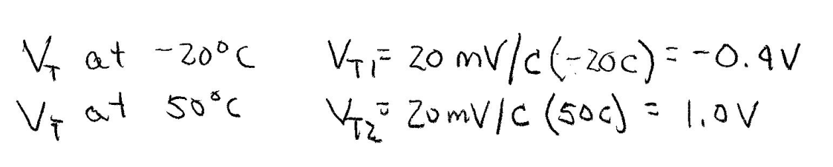
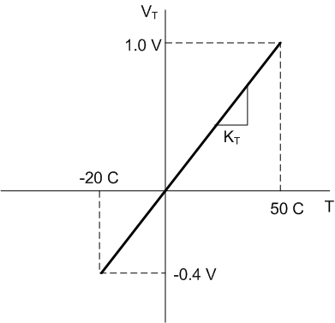
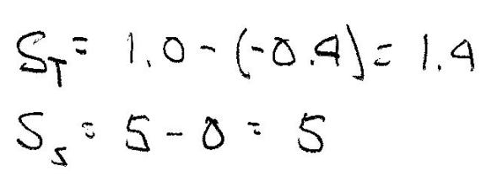
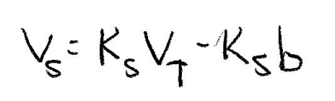
Example 4-5
A linear temperature transducer has an input range of -20 C to 50 C and a gain of K_{T} = 20 mV/C. The desired output range is 0 - 5 Vdc. The transducer output voltage is bipolar (+-). Find the scaling equation.
Compute the transducer and scalar span
Scalar formula
Find b graphically. Must shift origin to
(-20 C, -0.4 V)

Slide 16
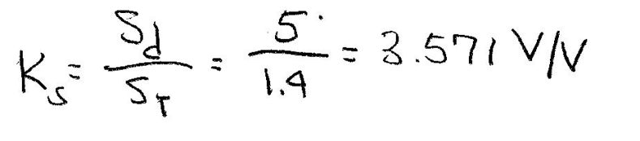
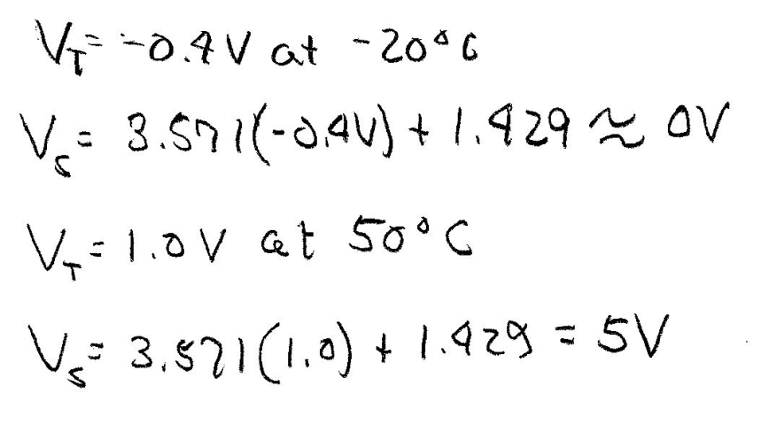
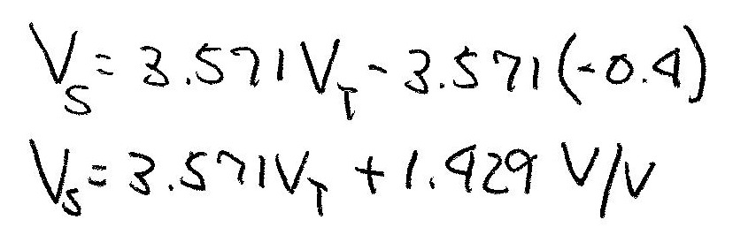
Example 4-5 Solution (2)
Find scalar gain
Check scalar equation at data points
Block Diagram
Input
Temp
V_{T}
V_{s}
Transducer
0.02x
Scalar
3.571V_{T}-1.429
T
Output
V_{T}= 0.02T
V_{s} = 3.571V_{T}-1.429

Slide 17
Practical Realization of Scalar Equations Using OP AMPs
V_{cc}
For inverting amps
R_{f}
R_{in}
V₀
Sensor
For non-inverting amps
Scaling without offset: use inverting or non-inverting amps to implement K_{s}

Slide 18
Practical Realization of Scalar Equations Using OP AMPs
For transducers with offset use inverting and summation amps
V_{b}
R_{b}
Stage 2 OP AMP changes sign if R_{f1} = R_{in} A_{V} = -1
R_{f}
R_{f1}
V_{T}
R_{T}
R_{in}
V_{s}
Stage 1
Stage 2
Stage 1
Overall gain

Slide 19
Practical Realization of Scalar Equations Using OP AMPs
V_{b}
R_{b}
R_{f}
R_{f1}
V_{T}
R_{T}
R_{in}
V_{s}
Stage 1
Stage 2
Equate the sensor with offset formula to the OP AMP gain derived on the last slide
so

Slide 20
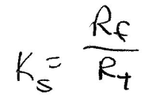
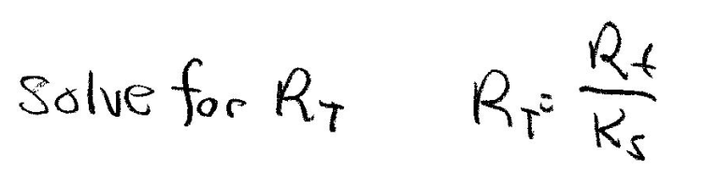
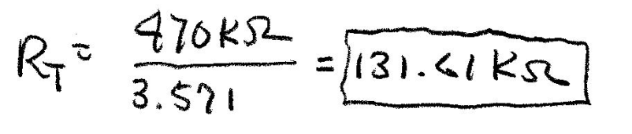
Example 4-6: Implementing Scalar Equation with OP AMPs
Design an OP AMP circuit that will implement the scalar equation from Example 4-5 Assume R_{f1} = R_{in} = 100 kΩ R_{f} = 470 kΩ
Scalar relationship for Example 4-5
V_{b}
R_{b}
R_{f}
R_{f1}
V_{T}
R_{T}
R_{in}
V_{s}
From scalar equation
K_{s}= 3.571
Stage 1
Stage 2

Slide 21
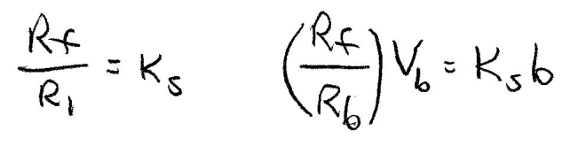
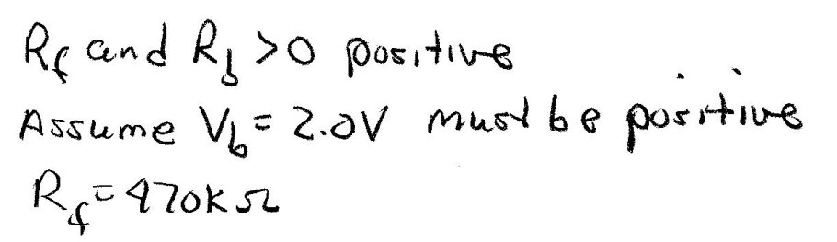
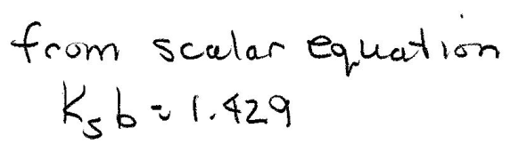
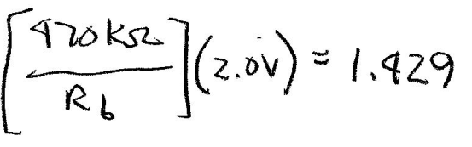
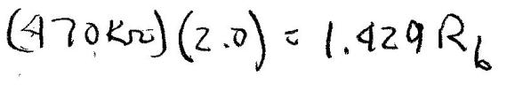
Example 4-6: Solution (2)
Value of R_{T} is not a standard value. Use a standard value near the computed value in series with a potentiometer and calibrate circuit. Use -0.4 and 1.0 V and adjust the potentiometer
127
k
10 k

Slide 22
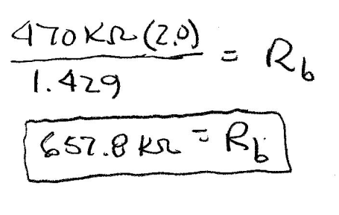
Example 4-6: Solution (3)
Compute the value of R_{b}
Simpler design method: Let R_{b}=R_{f}
So….
Set V_{b} to the numerical value of
K_{s}b

Slide 23
Example 4-6: Solution (4)
Completed design
V_{b}
R_{b}=657.8 k
R_{f}=470 k
R_{f1}= 100 k
V_{T}
V_{s}
R_{T}=131.6 k
R_{in}=100 k
Stage 1
Stage 2

Slide 24
End Lesson 4: Scaling Linear Sensors and Transducers
ET 438a
Automatic Control Systems Technology

